Slide 1
Artificial Intelligence
for Enterprise Applications
Predictive Maintenance Release 4.0 Major Features
June 2019
Notes:
Avanseus develops and markets data driven, context aware enterprise solutions. We focus on Big Data Analytics using Artificial Intelligence. Our technologies encompass Predictive Analytics, Streaming Analytics, Text Analytics, Machine Learning and Natural Language Processing.
Founded in 2015
Headquartered in Singapore
Research & Development (R&D), & Solution Commercialization Centre in Bangalore, India’s IT capital.
The Company has also planned offices in the United States (Q4 2015), and in Europe (Q2 2016).

Slide 2
Major features
ROE (Return on Effort) – Algorithmic prioritisation of predicted faults for NOC and field action
Improved Root cause Analysis framework for predicted fault
Simplification of operational complexity through additional automations
  Planned work
  Shared RAN sites
  Long pending tickets / inventory pending sites
Cross Domain Correlation (Transport and Radio)
Additional data source type configuration
Alarm filtering configuration

Slide 3
Return On Effort (RoE)
Since field service transformation happens gradually, there is a need to identify predictions which are most impactful so that work can start with these first. Based on our long experience of this requirement from many operators, Return on Effort (RoE) functionality is provided to deployments. It’s an algorithmic way to prioritise predictions. Customers are ok with our shortlisting.
ROE is an index/value on a scale of 0 to 100 (0 being the minimum and 100 being the maximum). It is an aggregated index/value based on individual index calculation on various important attributes of the predictions such as:
Ticket history 4. Average alarm duration
Site priority 5. Original alarm severity
Alarm cause priority 6. Alarm de-duplicated count

Slide 4
Return On Effort (RoE) - Continued
Every attribute in the previous slide is provided with a minimum and a maximum threshold. These threshold values are defined based on both raw data analysis and from our domain experience.
Furthermore, each attribute is given a weight during ROE index calculation. For example, we know that ticket history contributes more compared to average alarm duration.
To ensure the NoC chooses the right predictions to act on, we tag/color top predictions based on ROE index calculation.

Slide 5
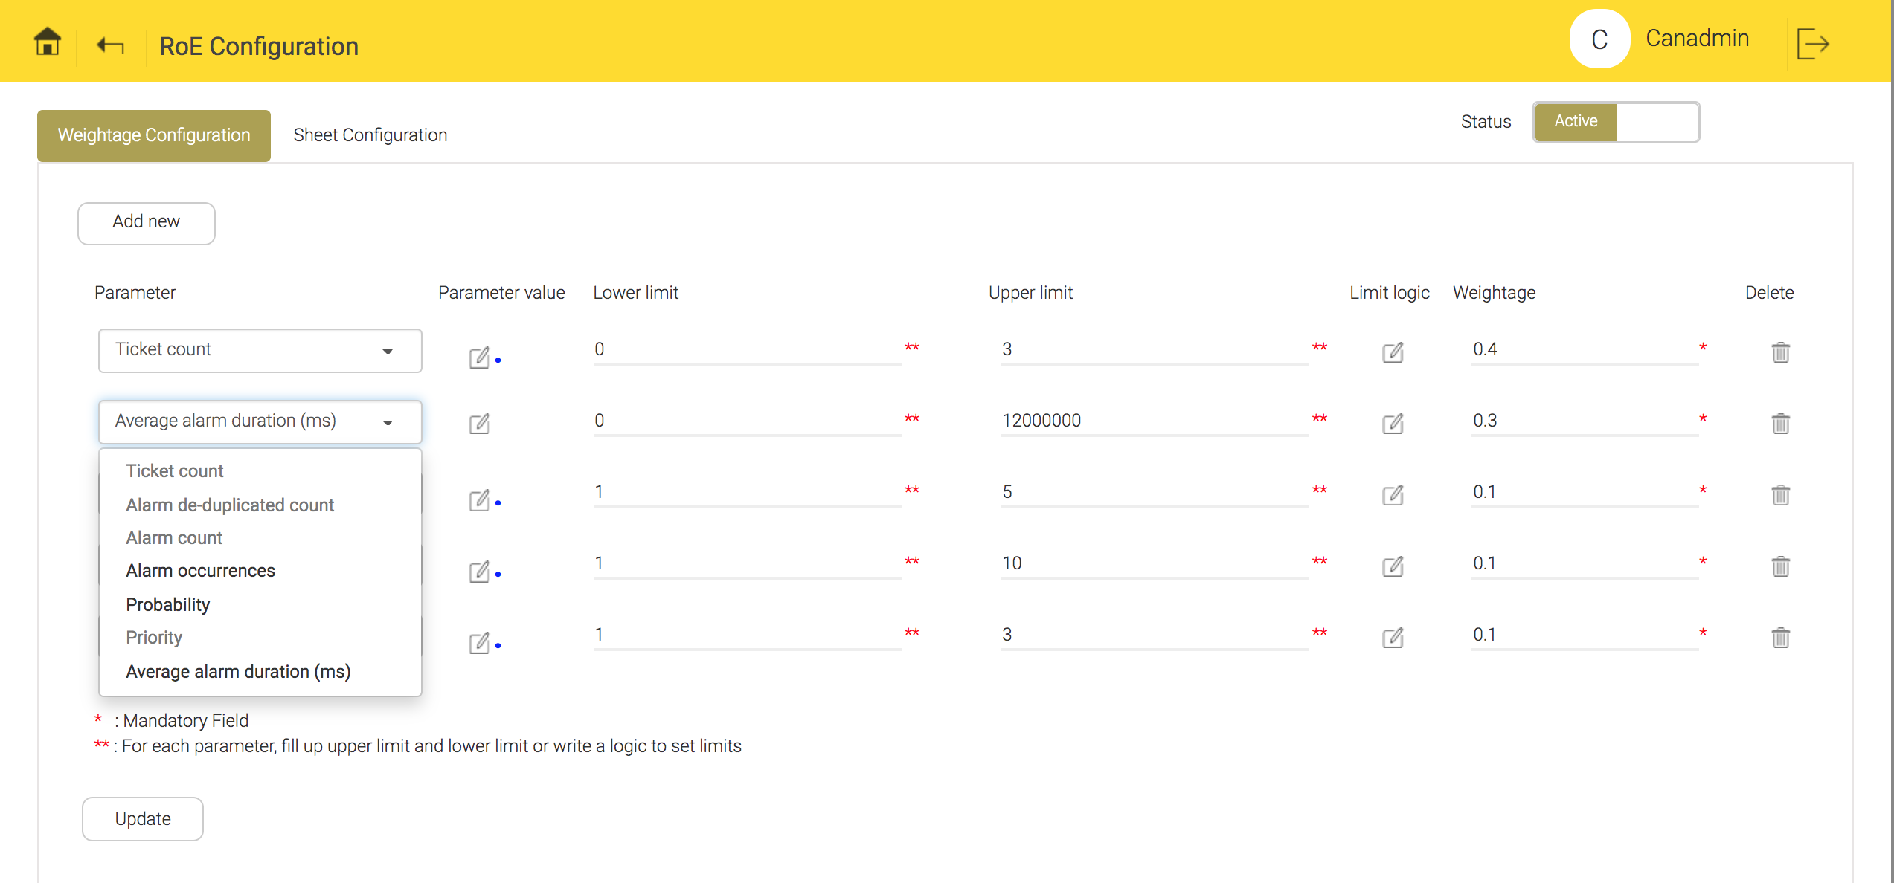
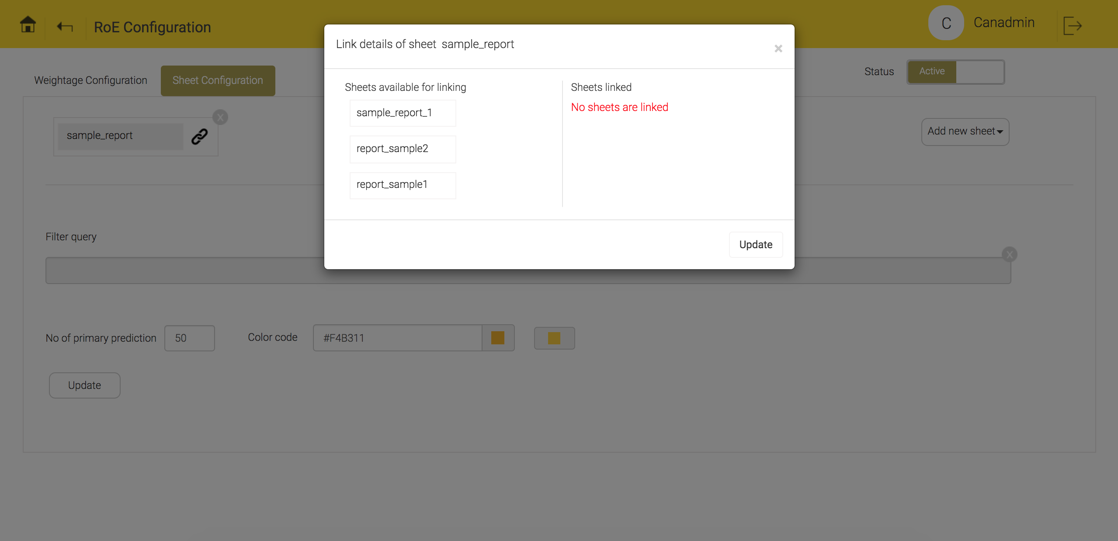
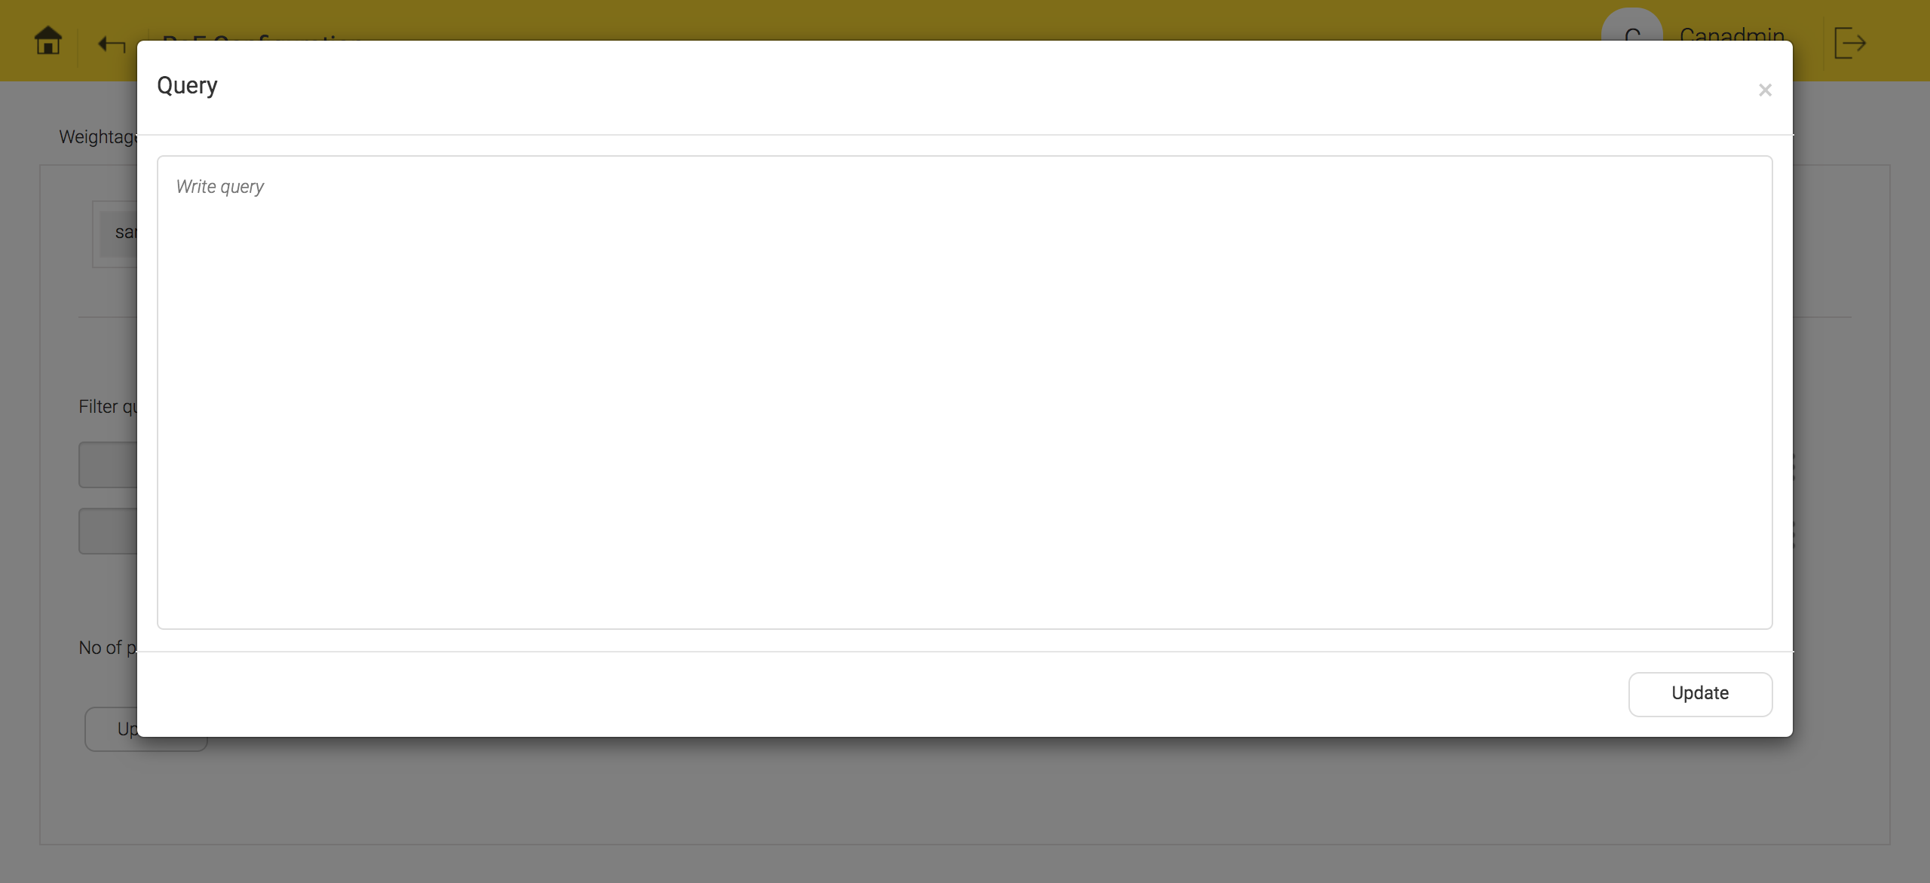
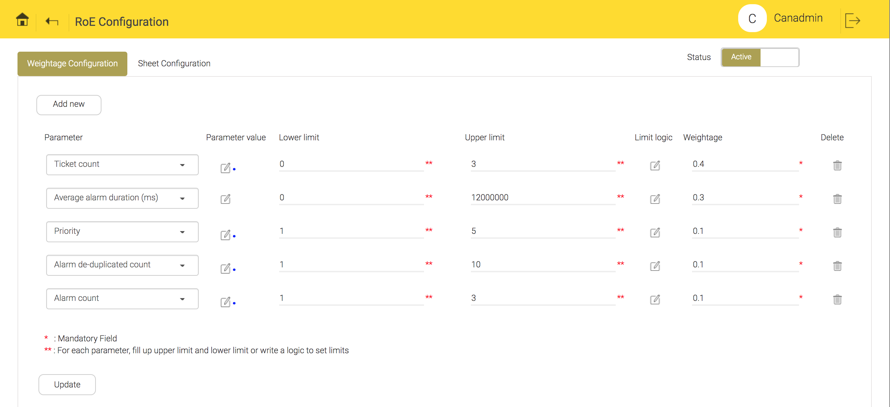
Return on effort (RoE) – Configuration snapshots
RoE parameter list view
Excel sheet mapping for RoE
Query formation for RoE
Weightage configuration for RoE

Slide 6
Root Cause Analysis
Operationalization of RCA is done by our proprietary two stage method.
Stage 1: Technical RCA – Root causes of predicted faults are provided based on experience of our domain experts on alarm types being predicted and alarm sequences that typically precede them (as per historical analysis)
Stage 2: Field learnt RCA – During operationalization, field team is requested to provide information back to us on what actually they found (as root cause) against our prediction. Our algorithm learns from these feedbacks, by associating these with alarm sequences prior to the fault.
Obviously, field learnt RCAs are more accurate than Technical RCA. Hence, a gradual replacement of Technical RCAs with Field learnt RCAs is followed as operationalization progresses.

Slide 7
Root Cause Analysis - Continued
Replacement rate of Technical RCA with Field learnt RCA is as follows, based on our experience with one field trial:
Month into field action | Technical RCA | Field learnt RCA
Month - 1 | 75% | 25%
Month - 2 | 50% | 50%
Month - 3 | 25% | 75%
Month - 4 | <10% | >90%

Slide 8
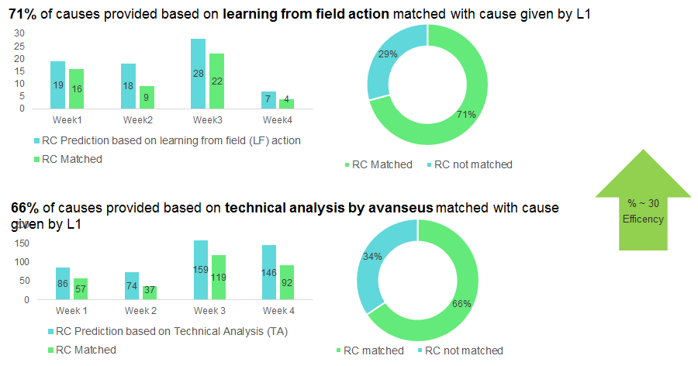
Root Cause Analysis – Results from a field trial

Slide 9
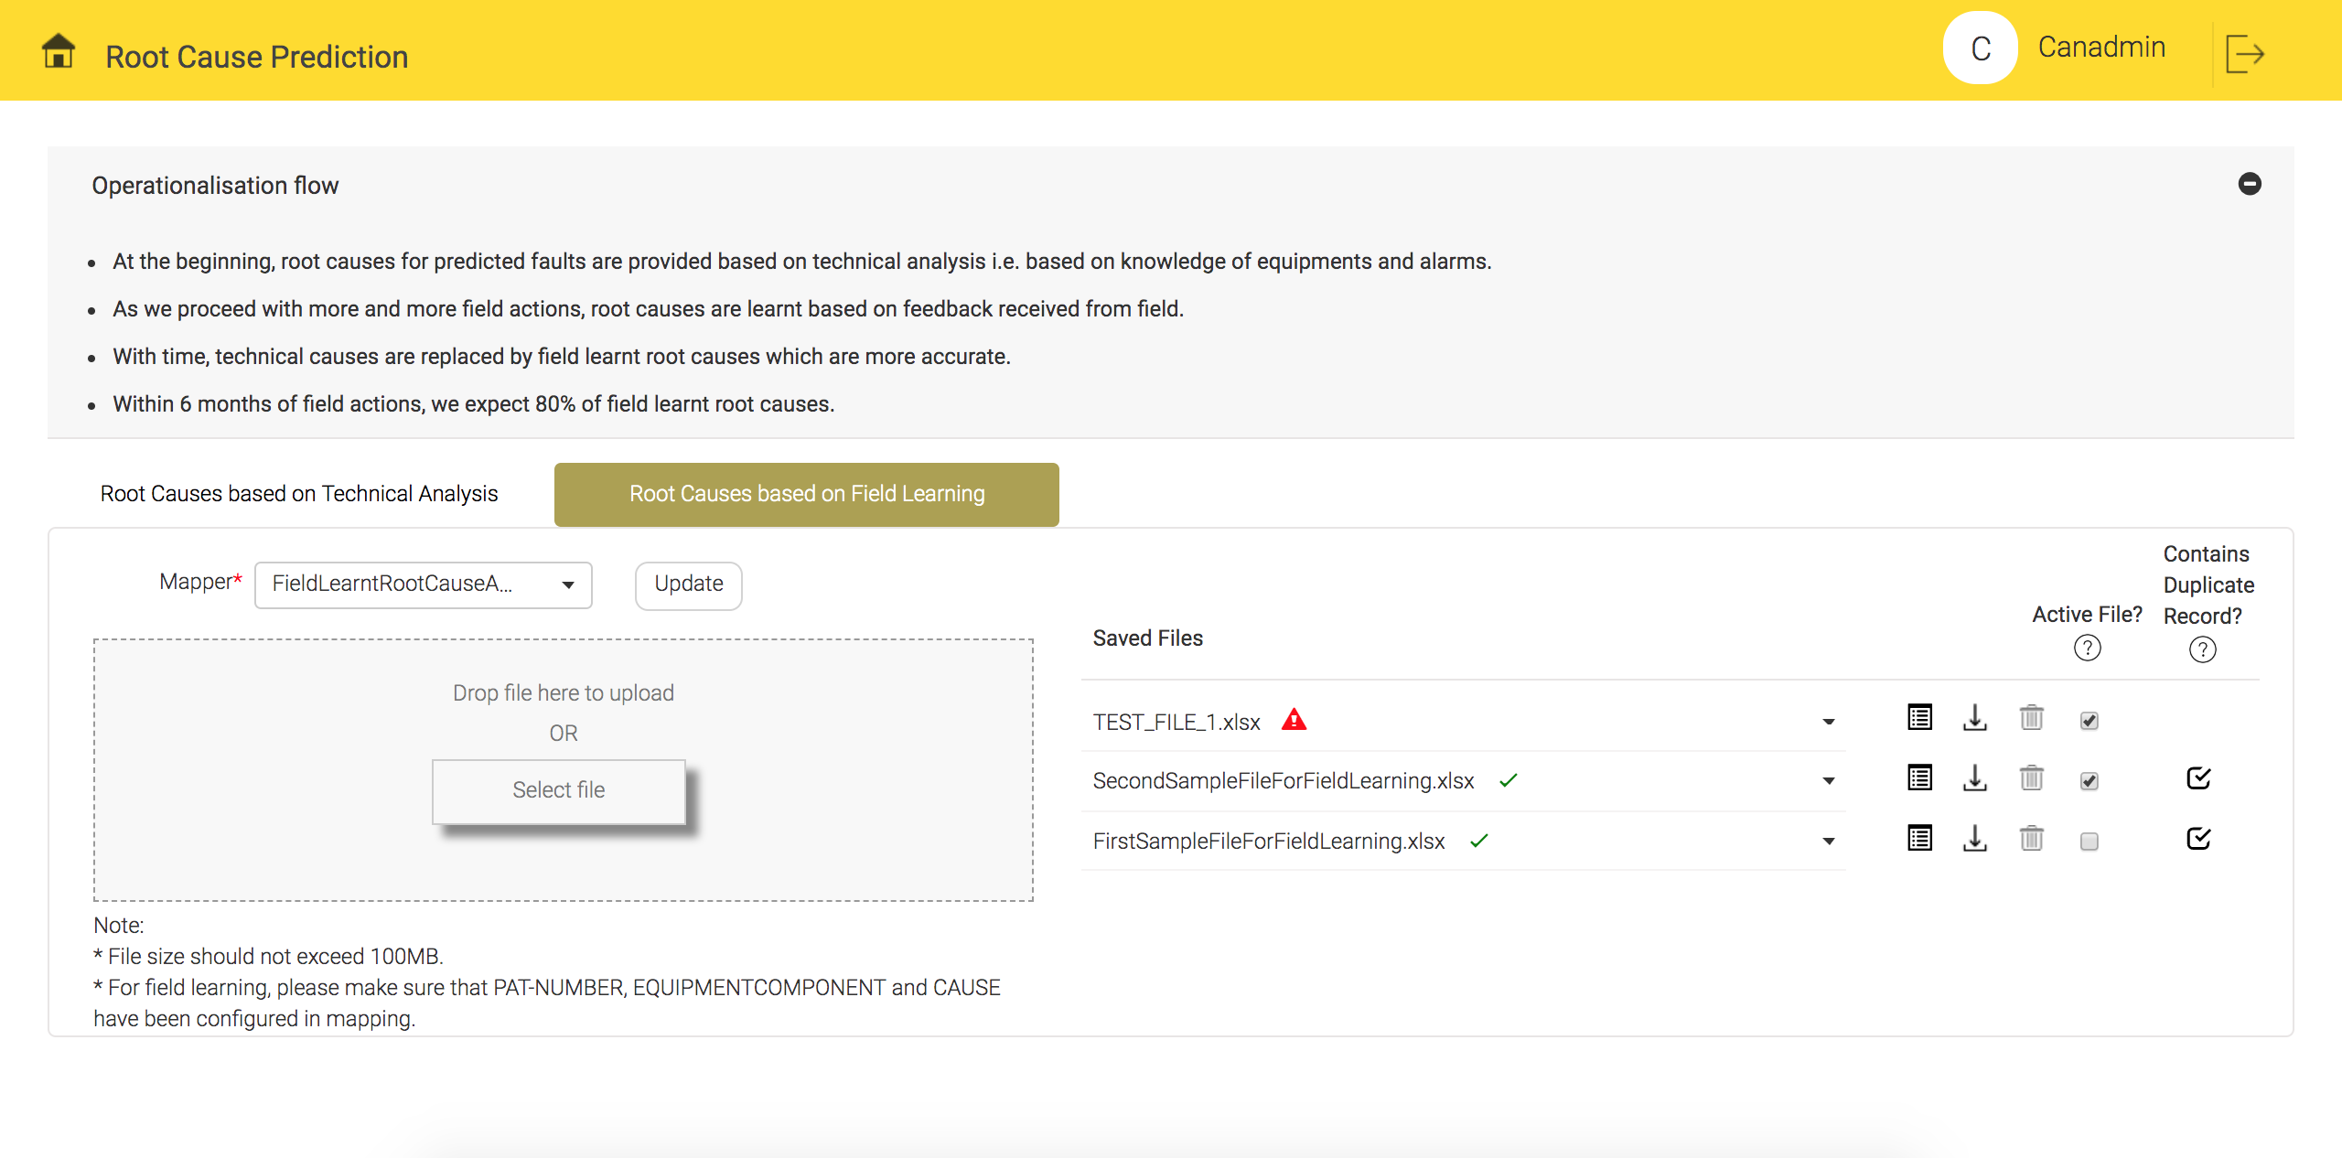
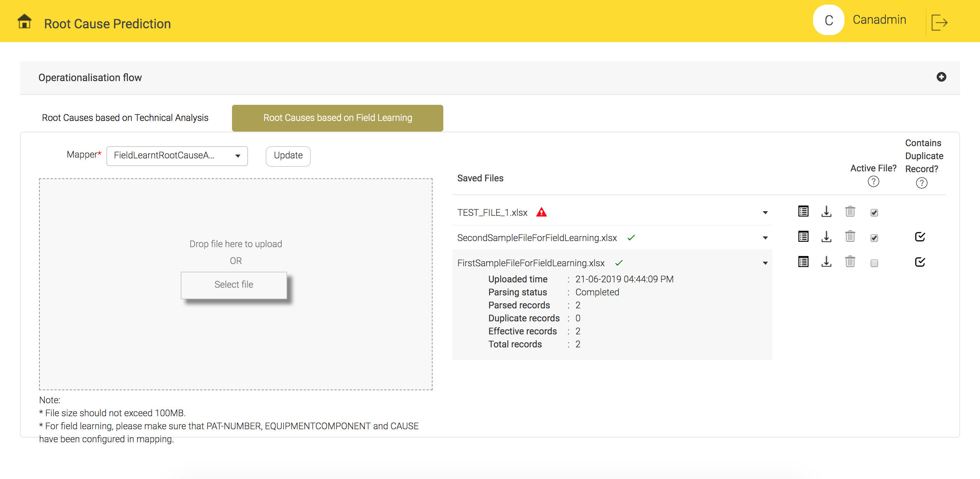
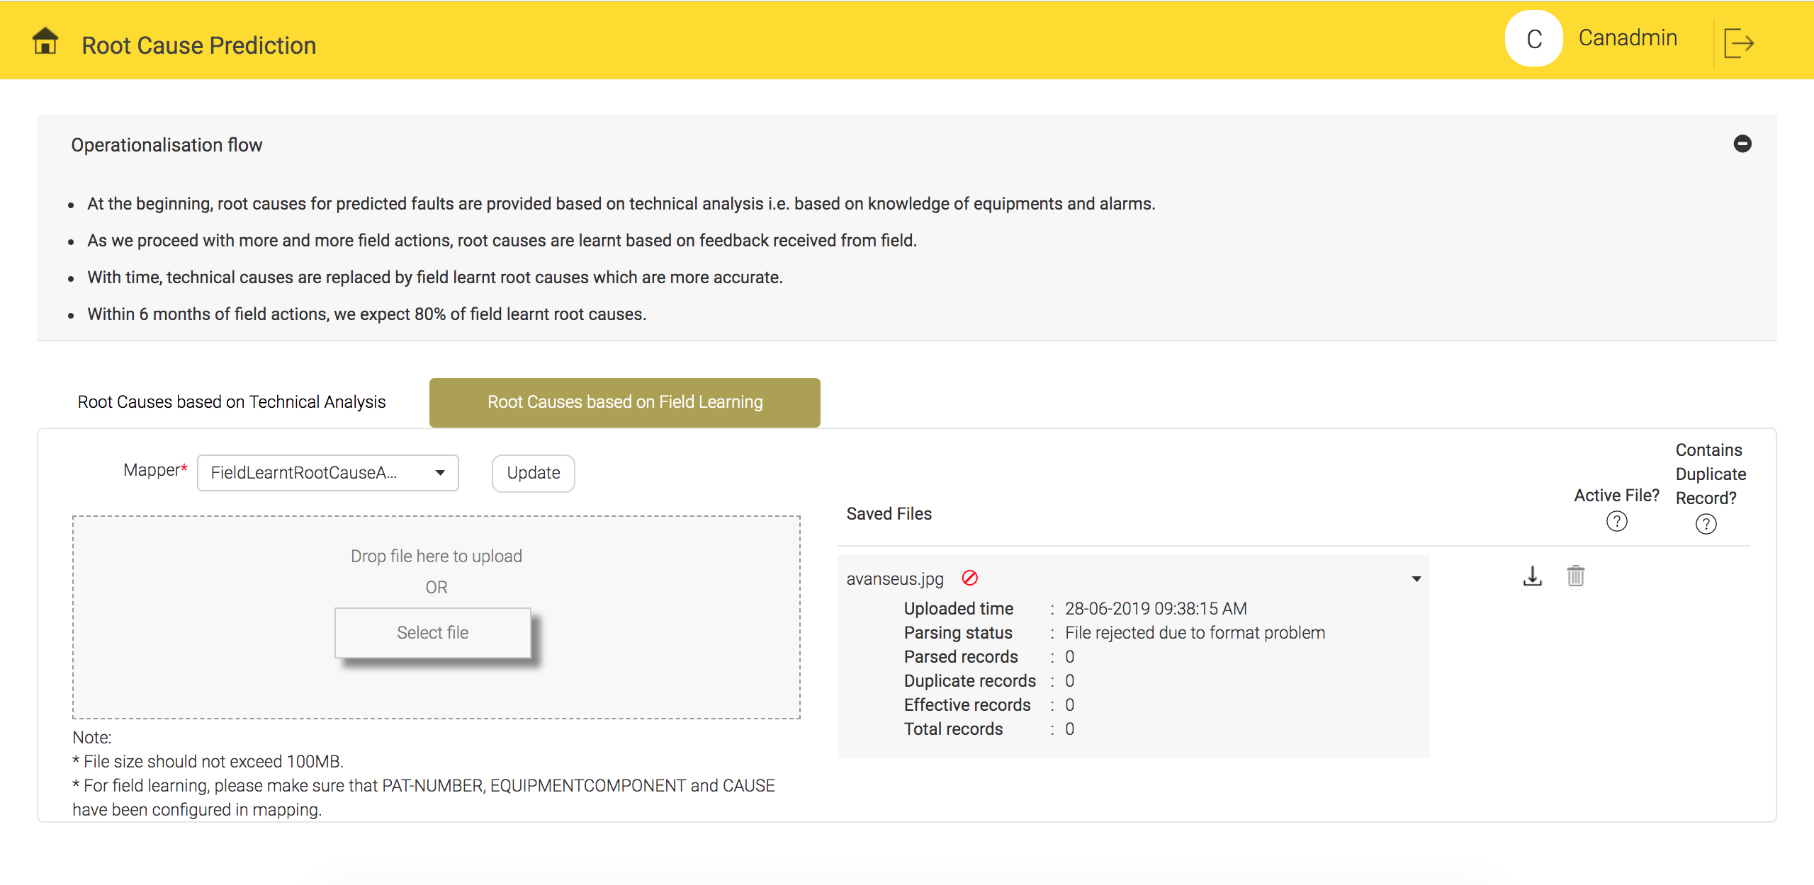
Root Cause Analysis – Configuration snapshots
File upload screen for RCA
File upload success and respective details
File upload failure and respective details

Slide 10
Simplification of operational complexity through additional automations
  Discard alarms on a particular site (all technologies) during the planned work schedule since we know that these alarms are dummy alarms which is expected to occur during a planned work. This will remove noise from alarms.
  When a prediction and planned work schedule overlaps, we tag the same in the prediction report to avoid working on the predicted fault during planned work window.
Automated consideration of RAN Sharing Network information
  Generally, sites hosted on a third party operator will not be serviced. This feature will help the NoC understand the list of sites which are shared and not hosted by the customer (operator). Predictions related to such sites are discarded/tagged for proper decision making.
Automated consideration of planned work

Slide 11
Simplification of operational complexity through additional automations
Automated consideration of known faulty equipments
  Faulty sites/Long pending tickets/inventory pending sites – This feature will help identify and tag predictions for faulty sites (sites with very frequent problems and alarms which cannot be solved due to various reasons), sites with long pending reactive tickets with known problems, inventory pending sites etc.

Slide 12
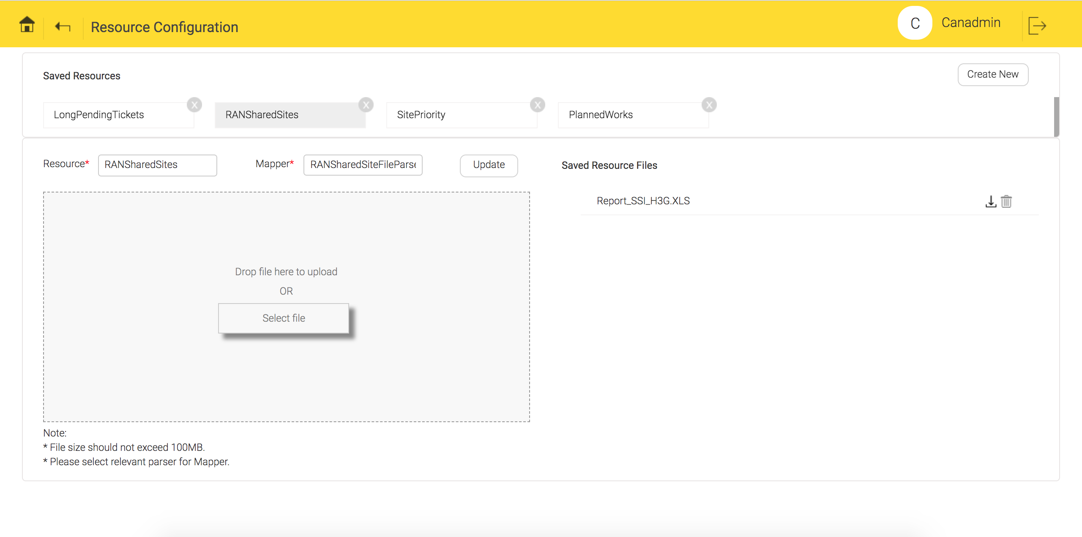
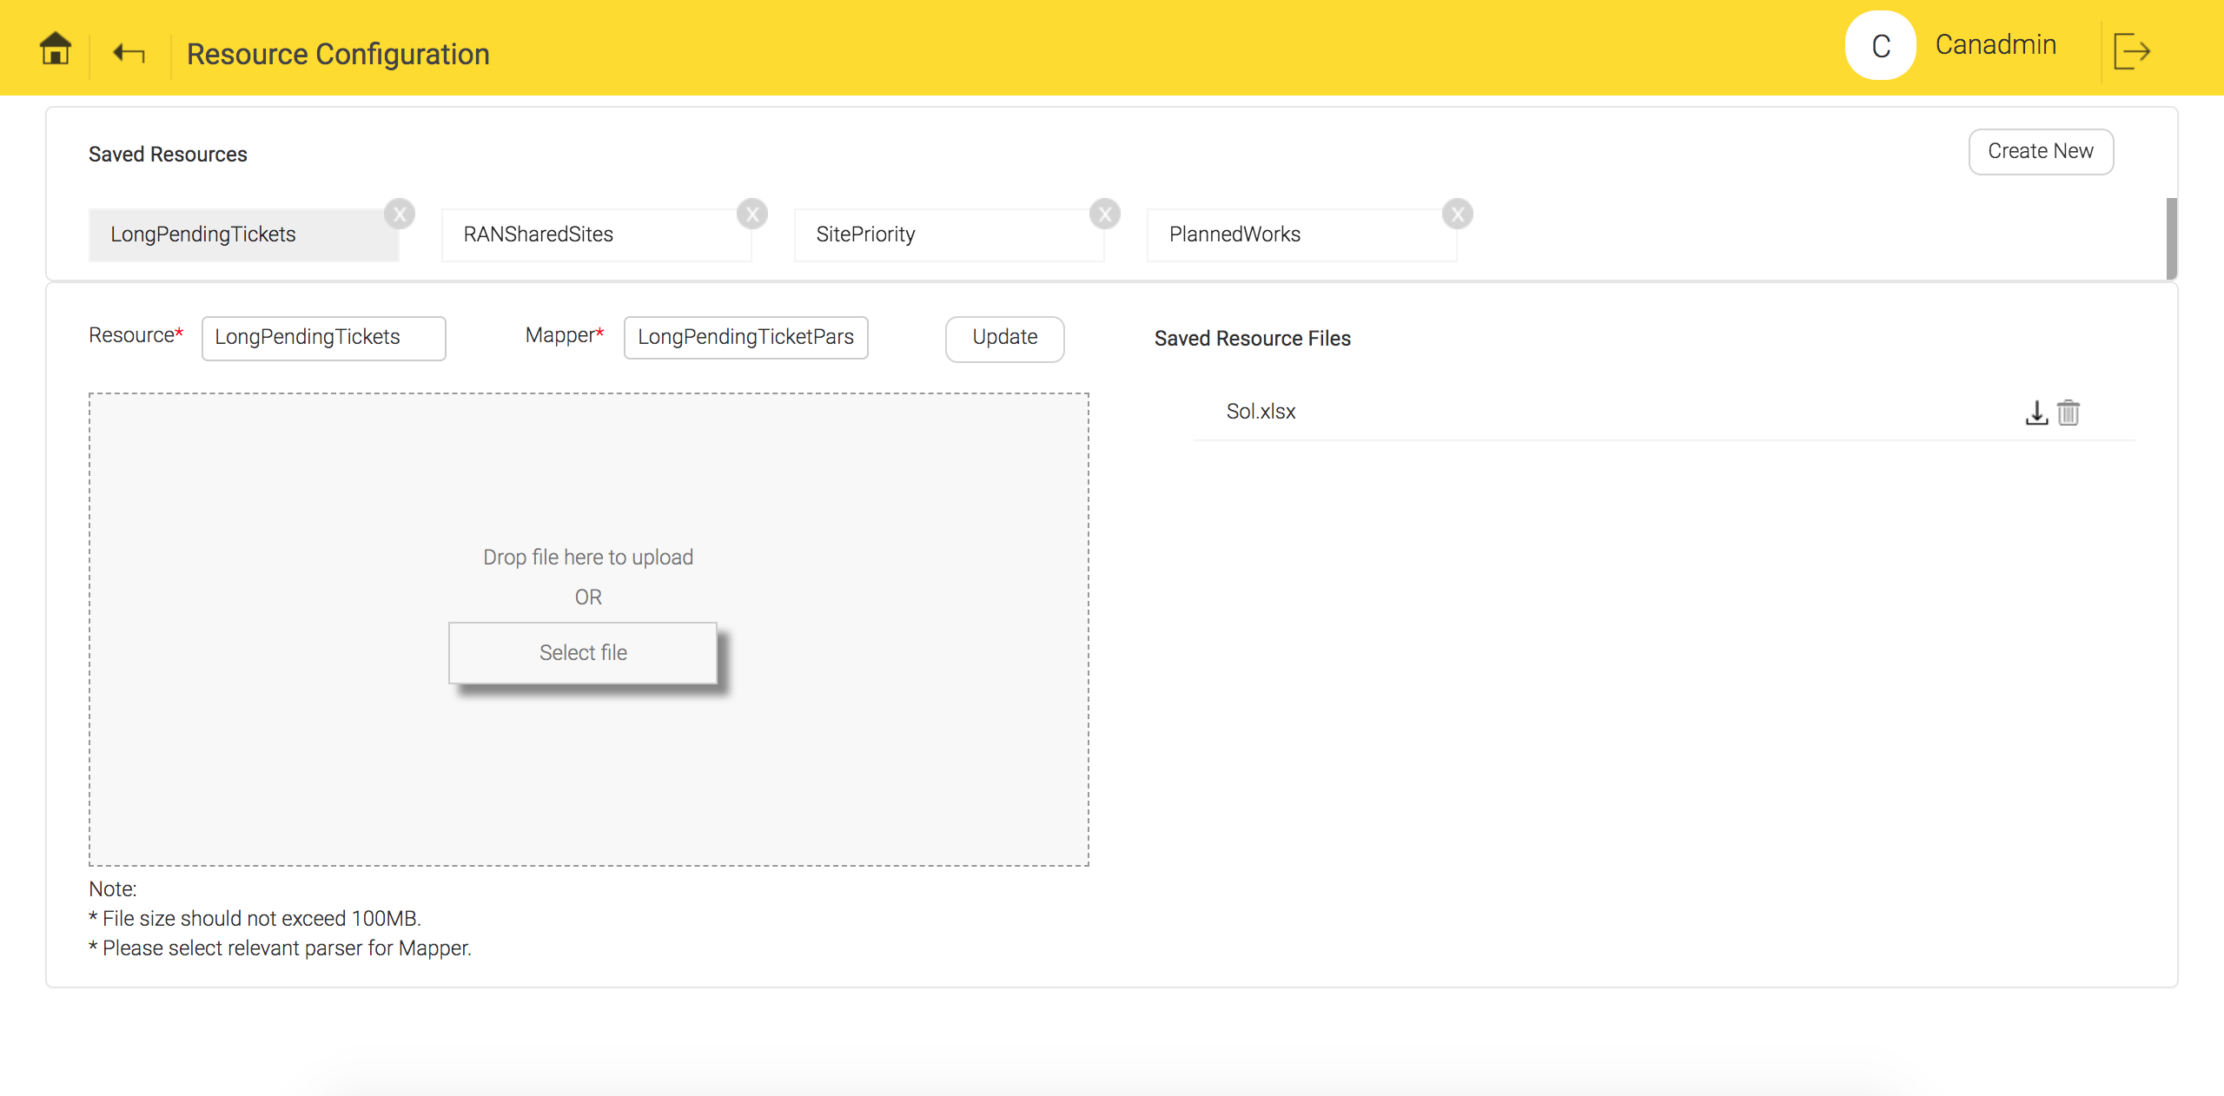
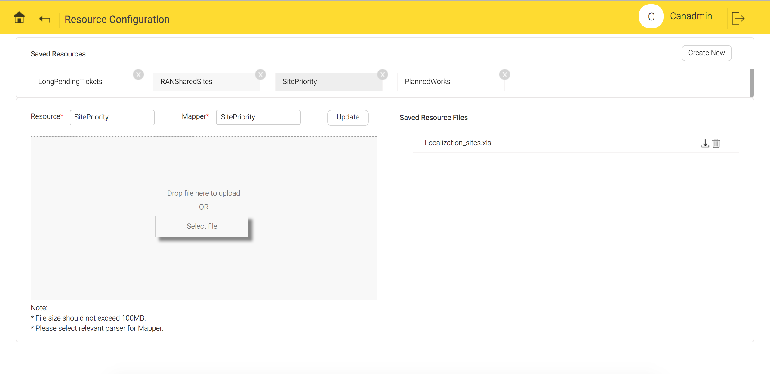
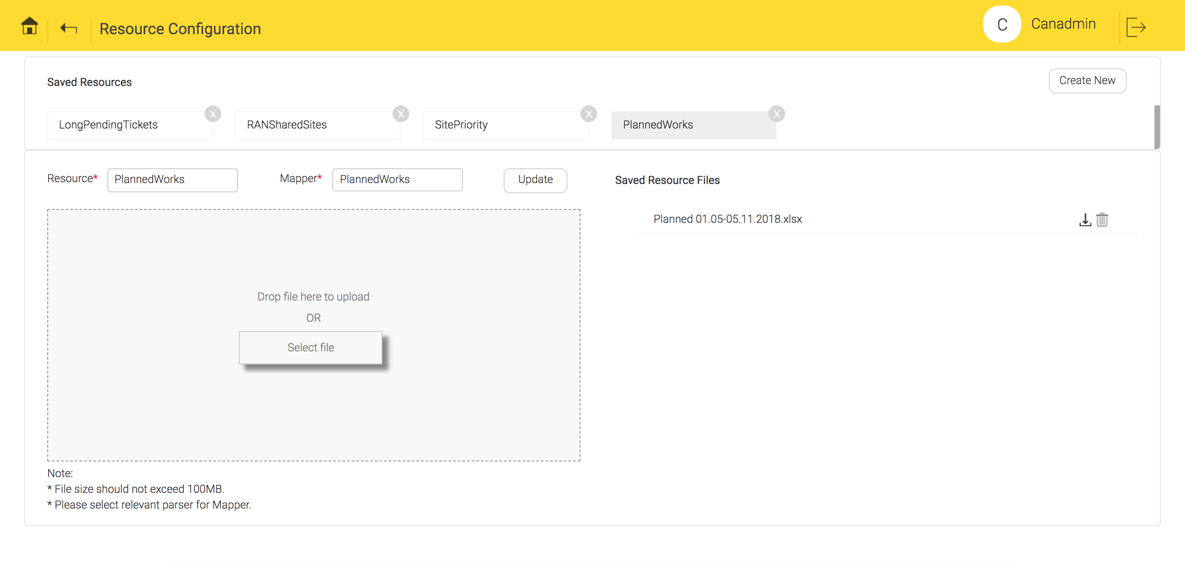
Simplification of operational complexity through additional automations
- Configuration snapshot
Shared sites resource configuration sample
Long pending tickets configuration sample
Site priority resource configuration sample
Planned work resource configuration sample

Slide 13
Cross-domain correlation
This is performed to understand root cause of problems we are predicting. In some cases, faults propagate from one domain to other domain because of network connections. We discover network topology based on fault occurrence sequence and use it for correlation. Wherever topology is available from operator easily, we use the same. Already, more than one prospects have used our topology discovery and shared positive experiences.
This helps in understanding 2 things:
Faults which are similar and occur together in the network across different sites
Gives fault correlation across different technologies/domains

Slide 14
Cross-domain correlation – Result from field trial
Cross domain correlation with clustering was implemented for one of the prospects where we correlated faults across Access and Transport domain.
During the trial of 2 months, following results were noticed:
Around 18.6% of total predictions were clustered or had correlation information
Out of the above 18.6% clustered predictions, 11.3% predictions were clustered across Access and Transport domain.

Slide 15
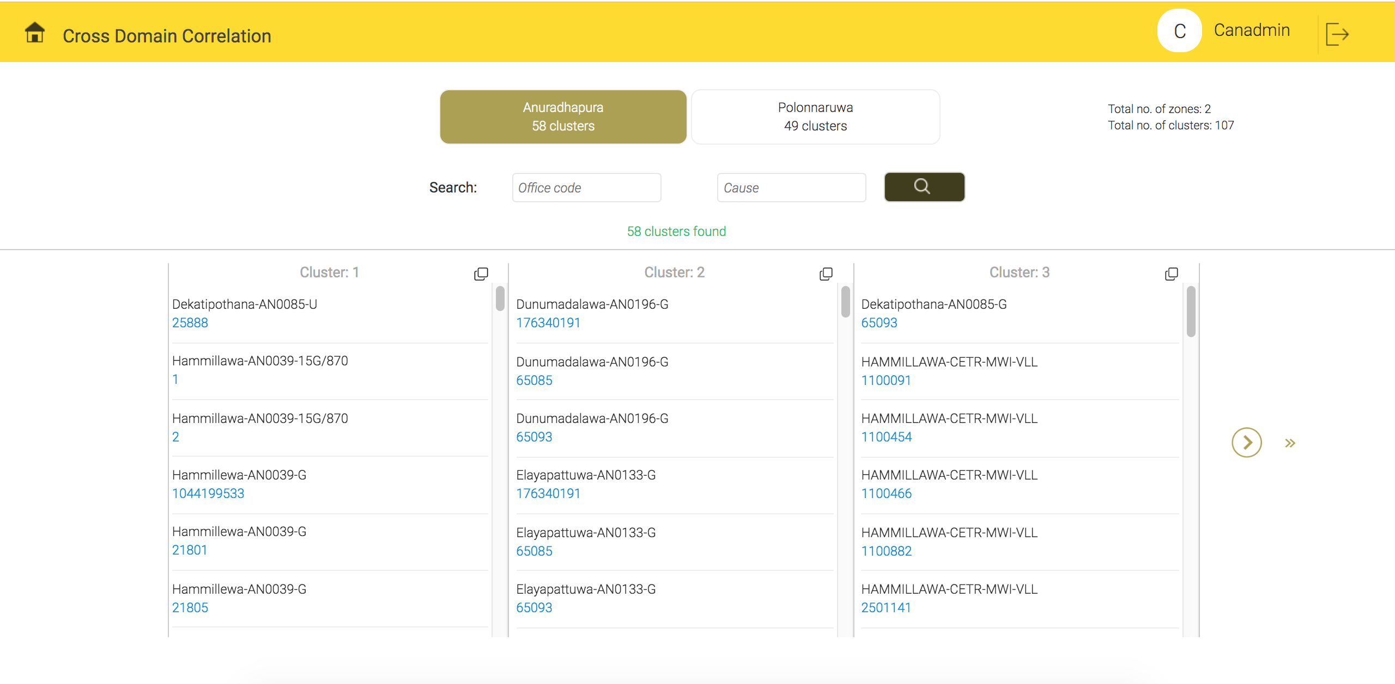
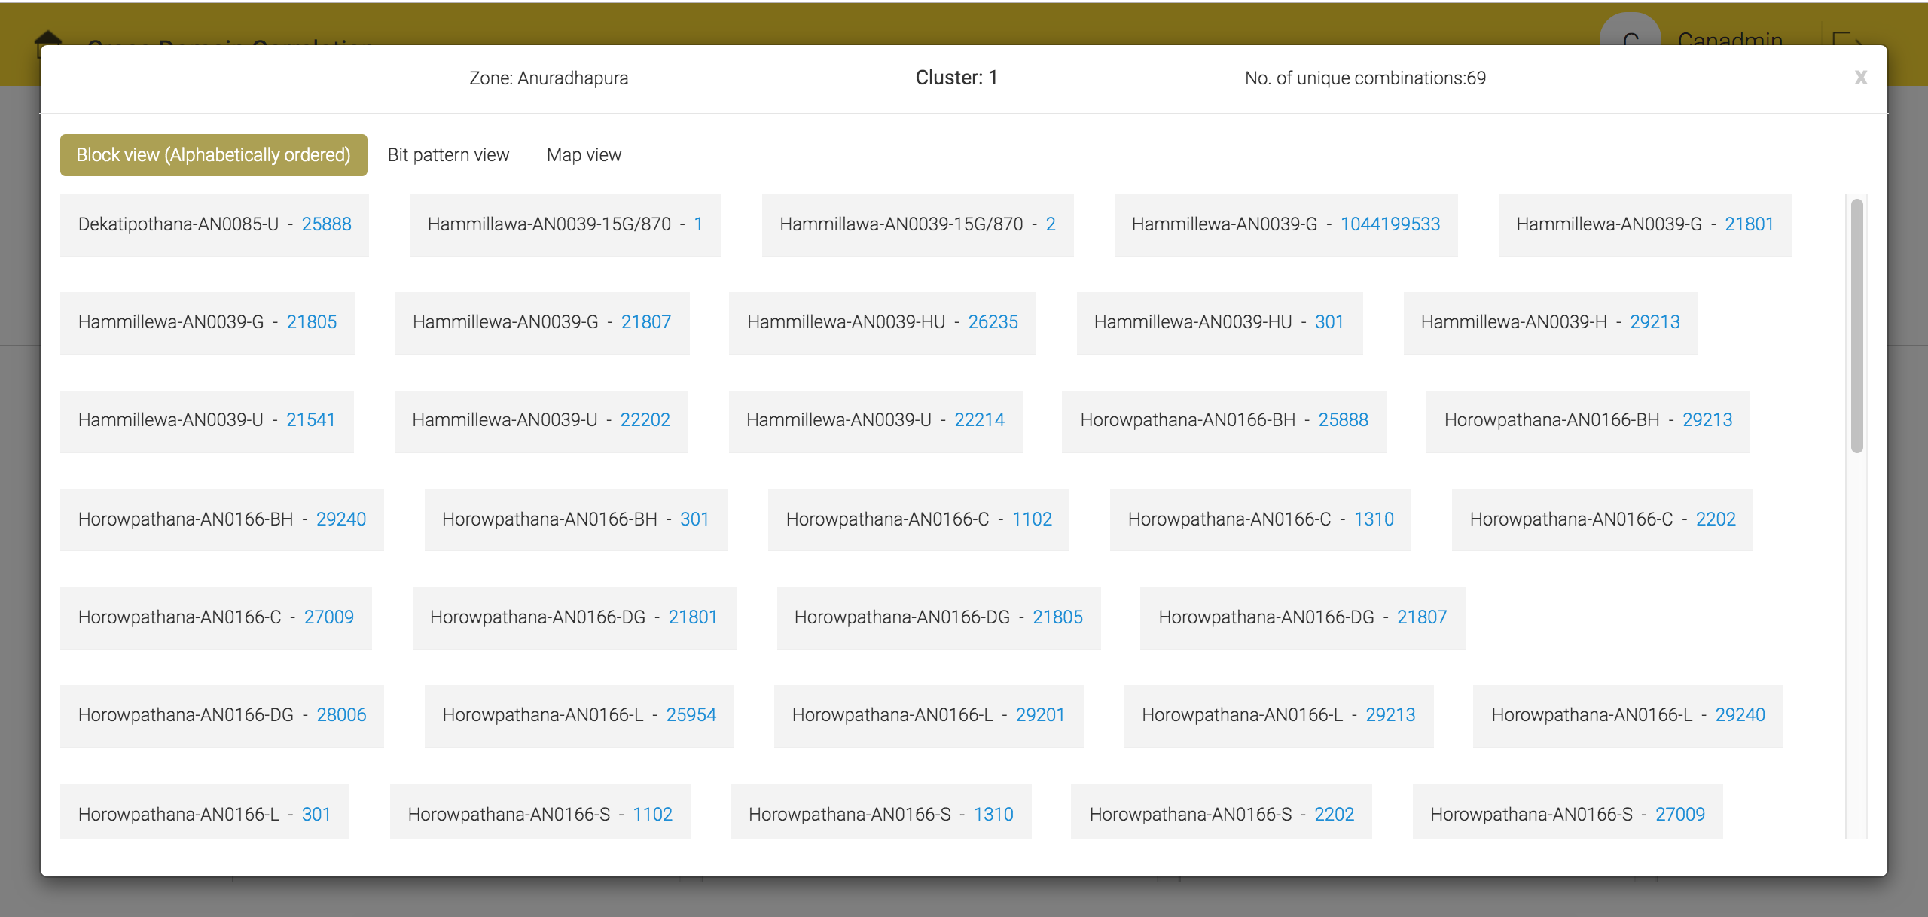
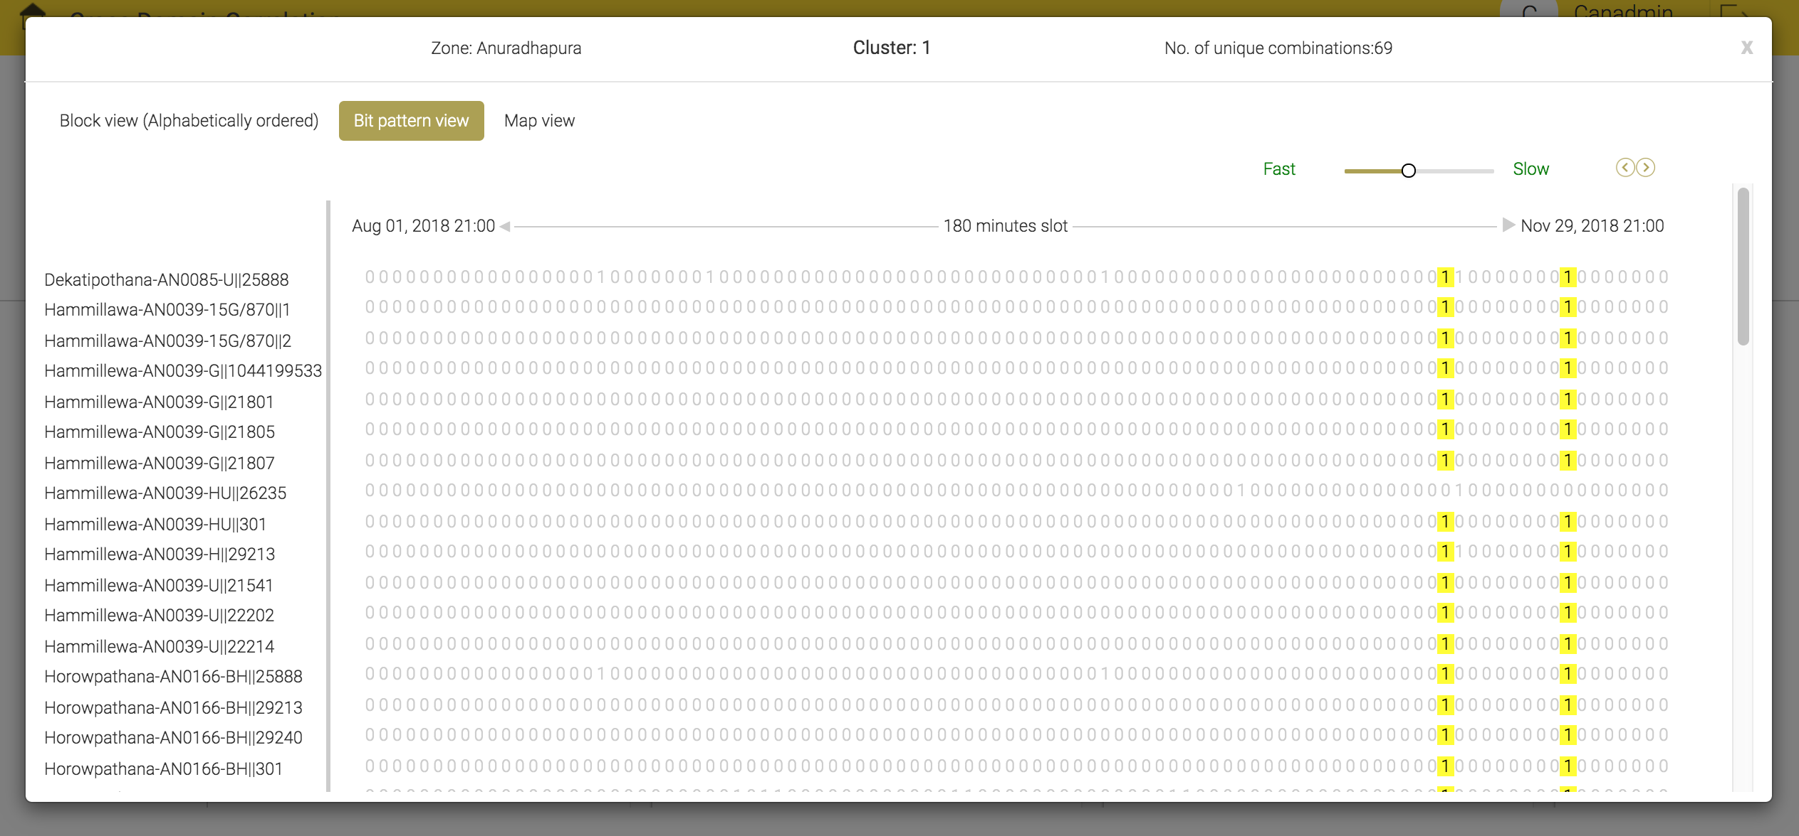
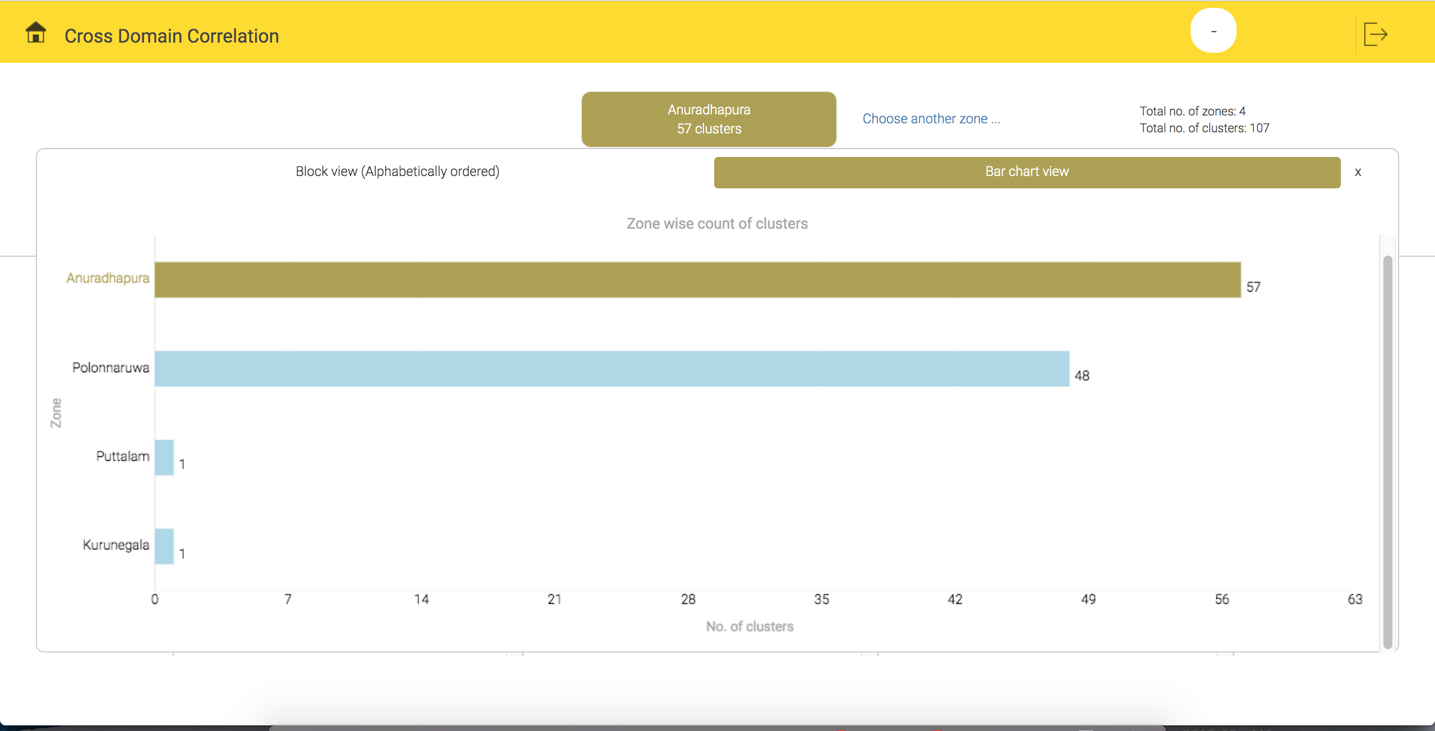
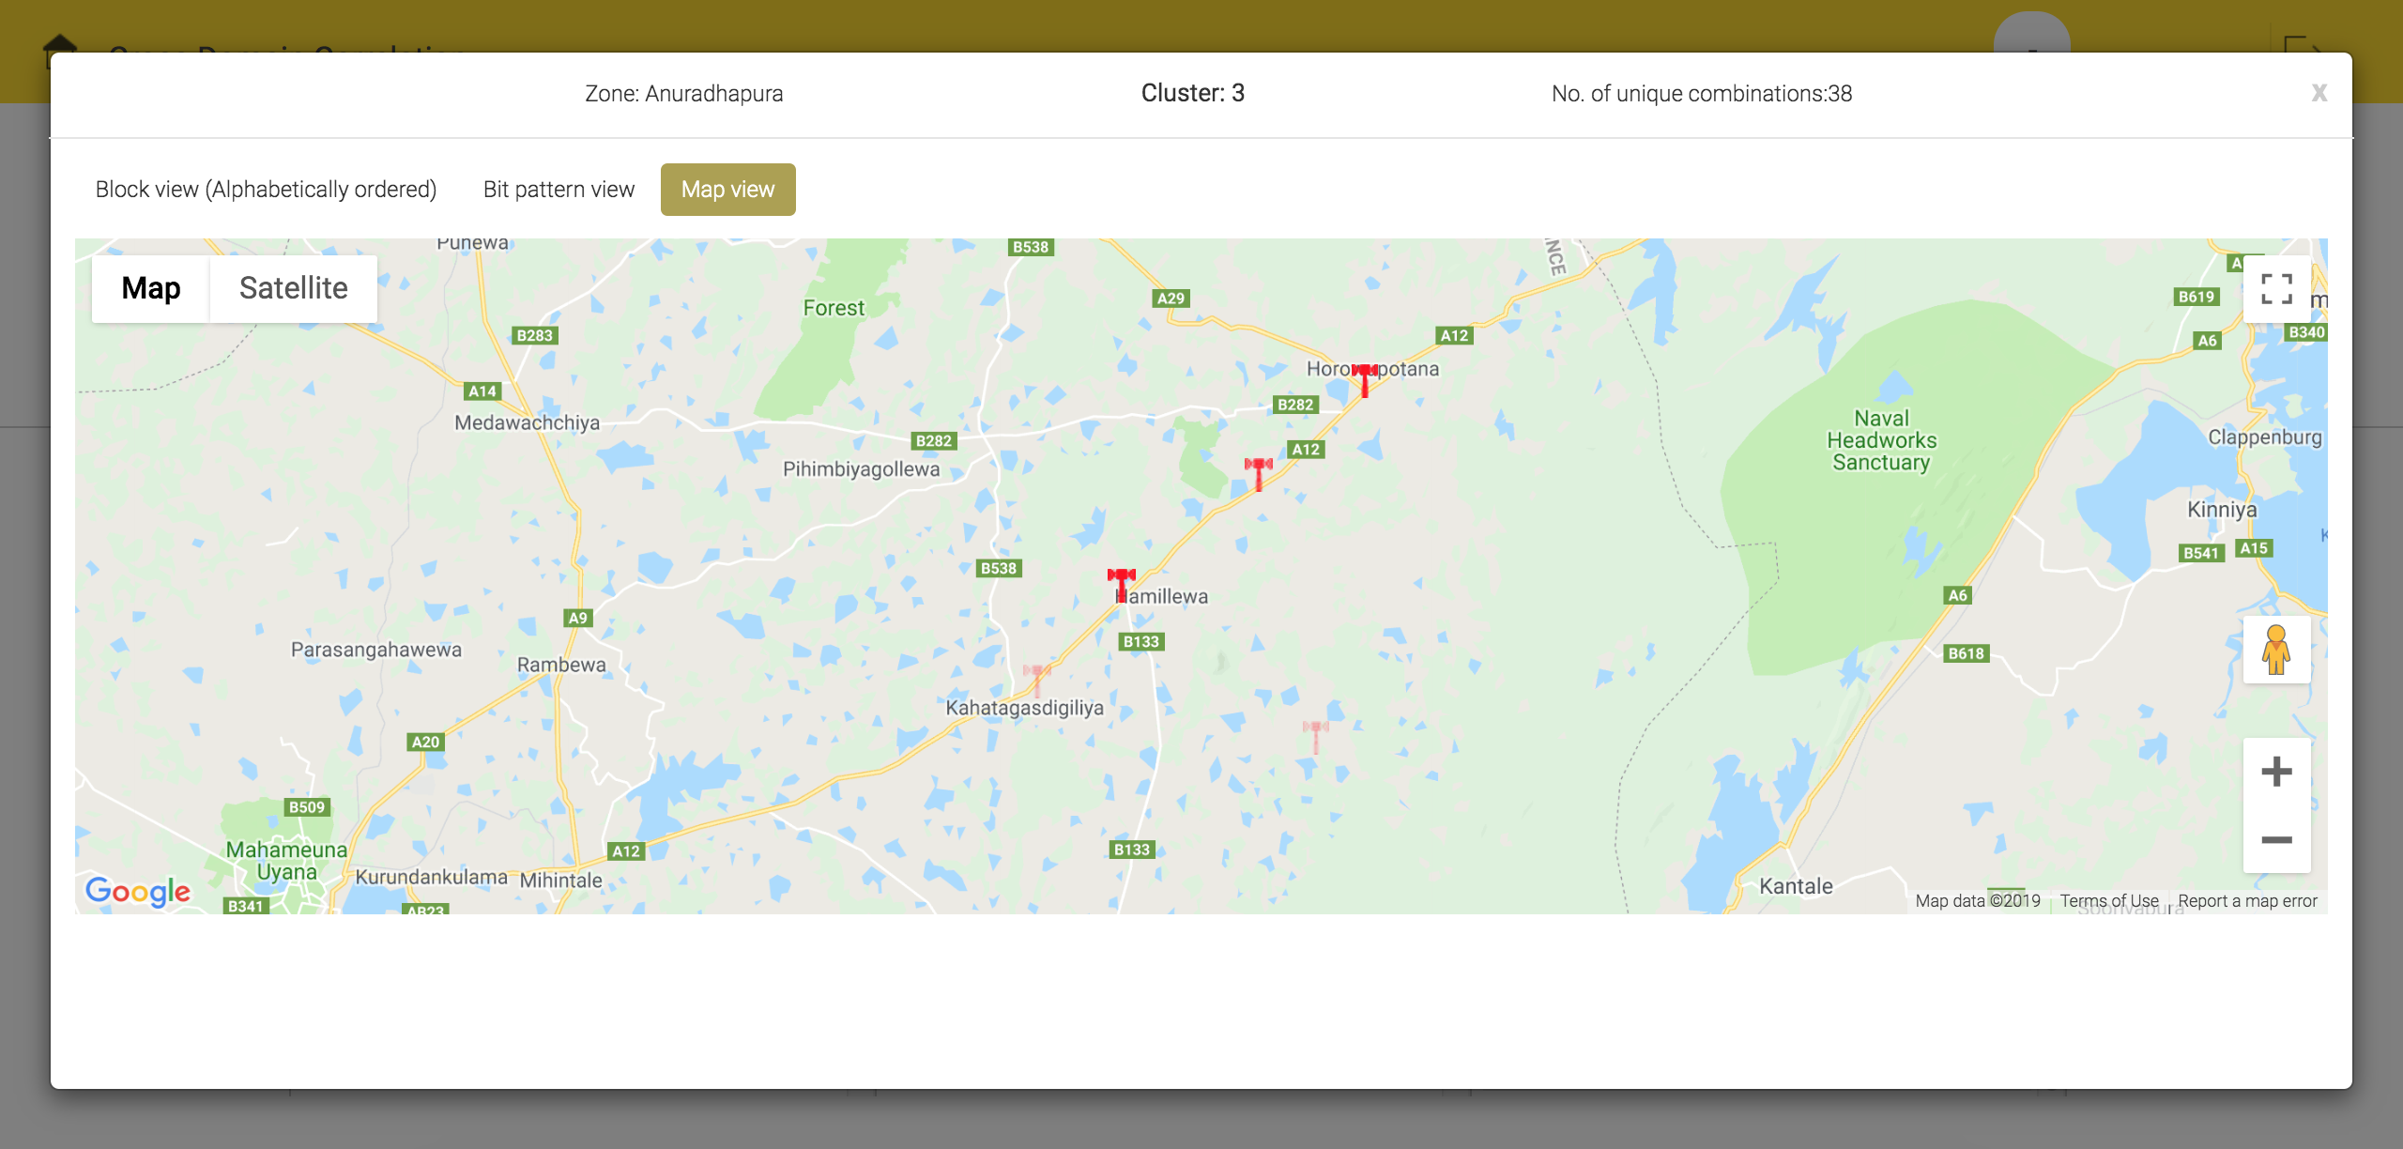
Cross domain correlation – Tracker snapshots
Basic clusters view
Block view of a single cluster
Bit pattern view of faults in a cluster
Zone wise bar chart view
Zone wise map view for clustered faults

Slide 16
Additional data source type configuration
Earlier the data parser in CAN was allowed to be configured only for Alarm data. Now an option is available in parser to select desired data source types.
These data source types are:
Alarm – To process alarm data
Trouble ticket – To process ticket data
Performance counter – To process performance counter KPI
Others – Allows custom data source processing

Slide 17
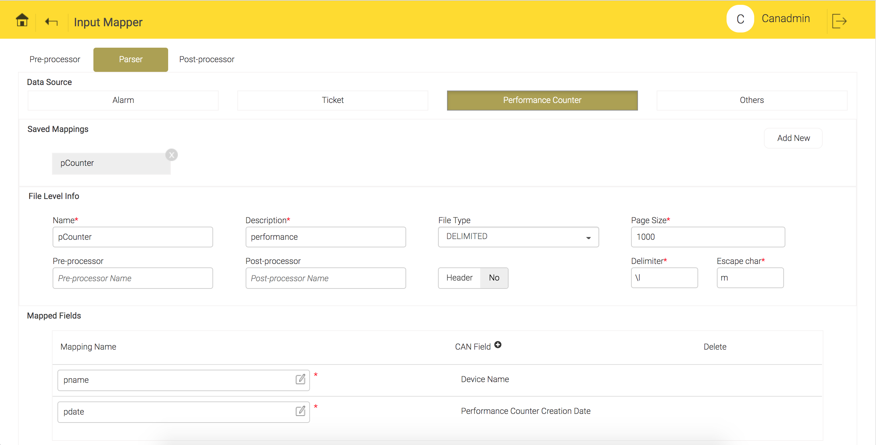
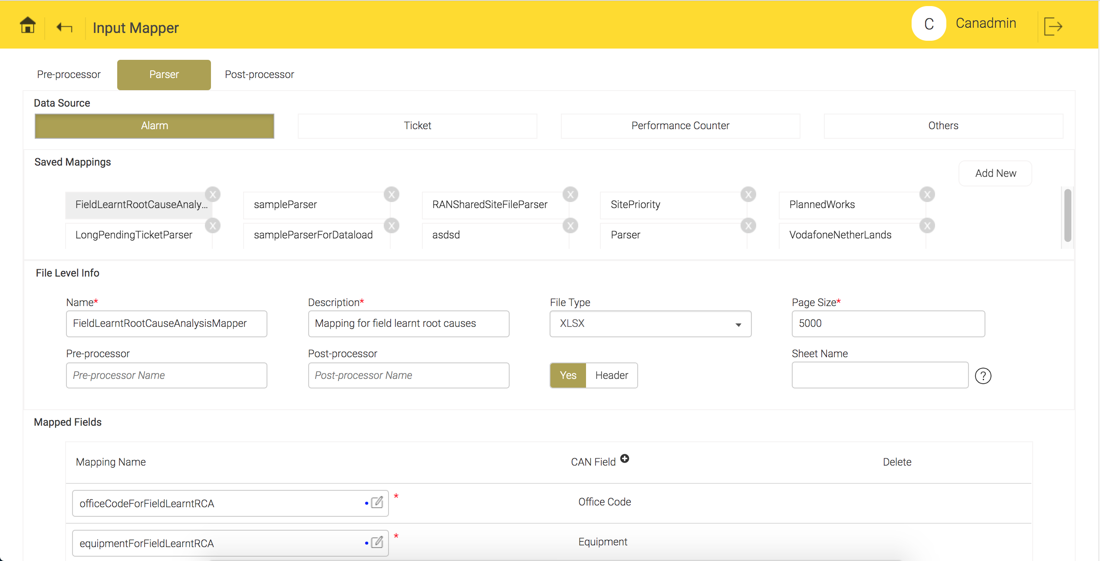
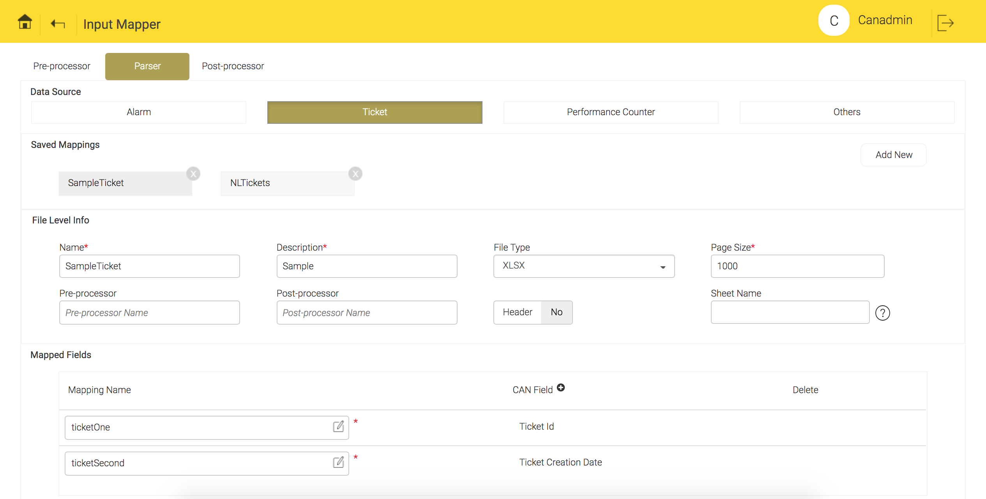
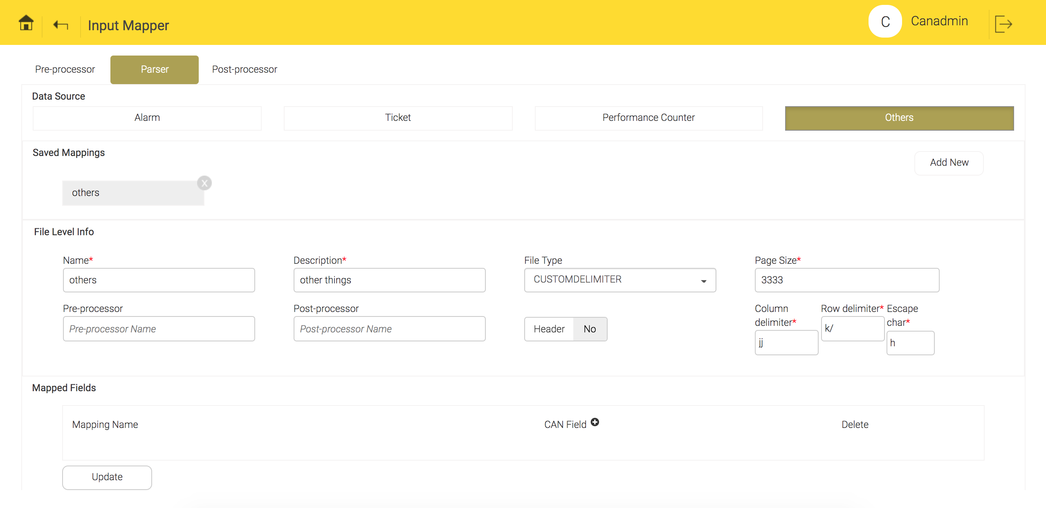
Additional data source type configuration – Configuration snapshots
Performance counter parser configuration
Alarm parser configuration
Trouble ticket parser configuration
Custom data source parser configuration

Slide 18
Alarm filtering configuration
Alarm filtering configuration is a way to configure the specific alarms to be included or excluded as part of daily alarm ingestion. This of course affects the prediction and KPI calculation since both depend on alarm volume.
This feature is an efficient way of enforcing filter rules to separate the input data by formulating filter queries:
Keeps only the required alarms in working storage and hence reduces the load.
Allows flexible selection based on exclusion, inclusion, regular expression and file based condition specification.

Slide 19
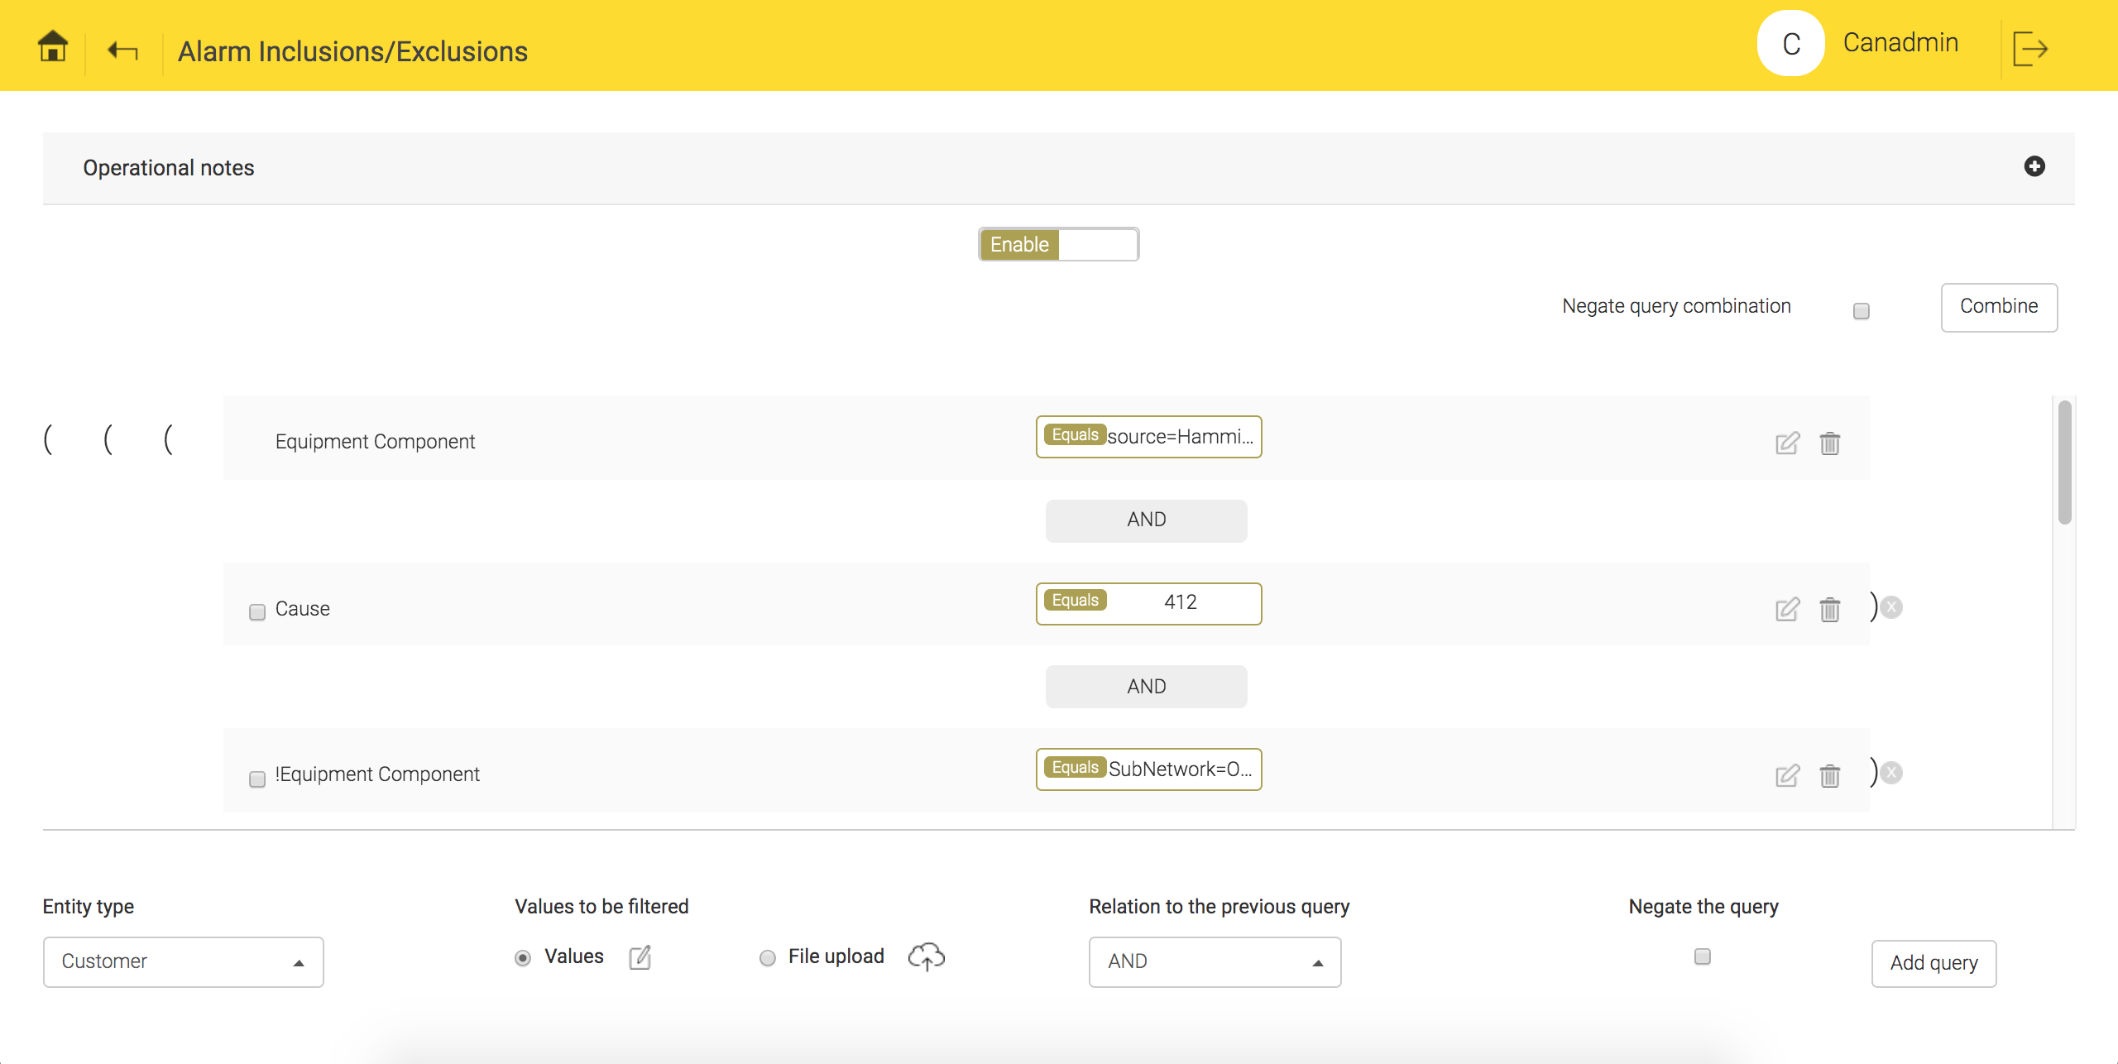
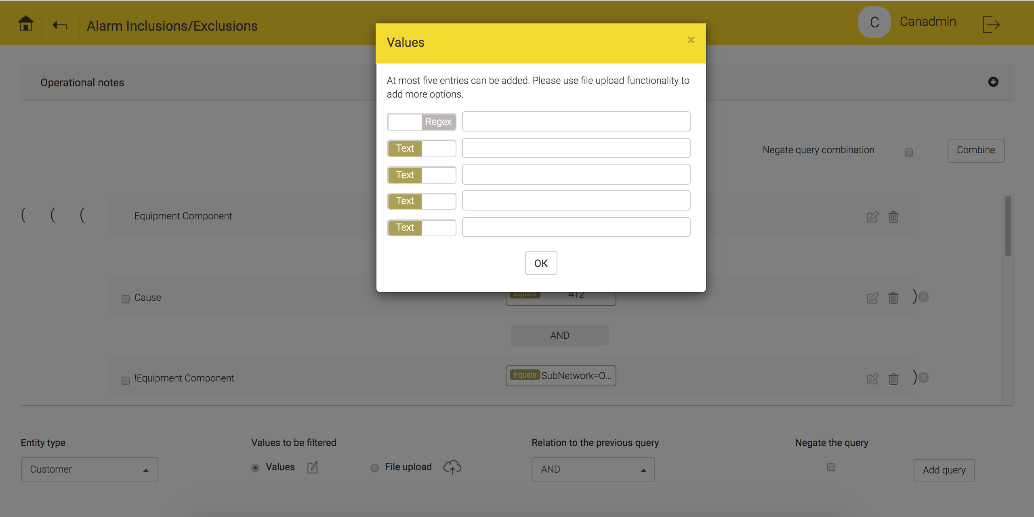
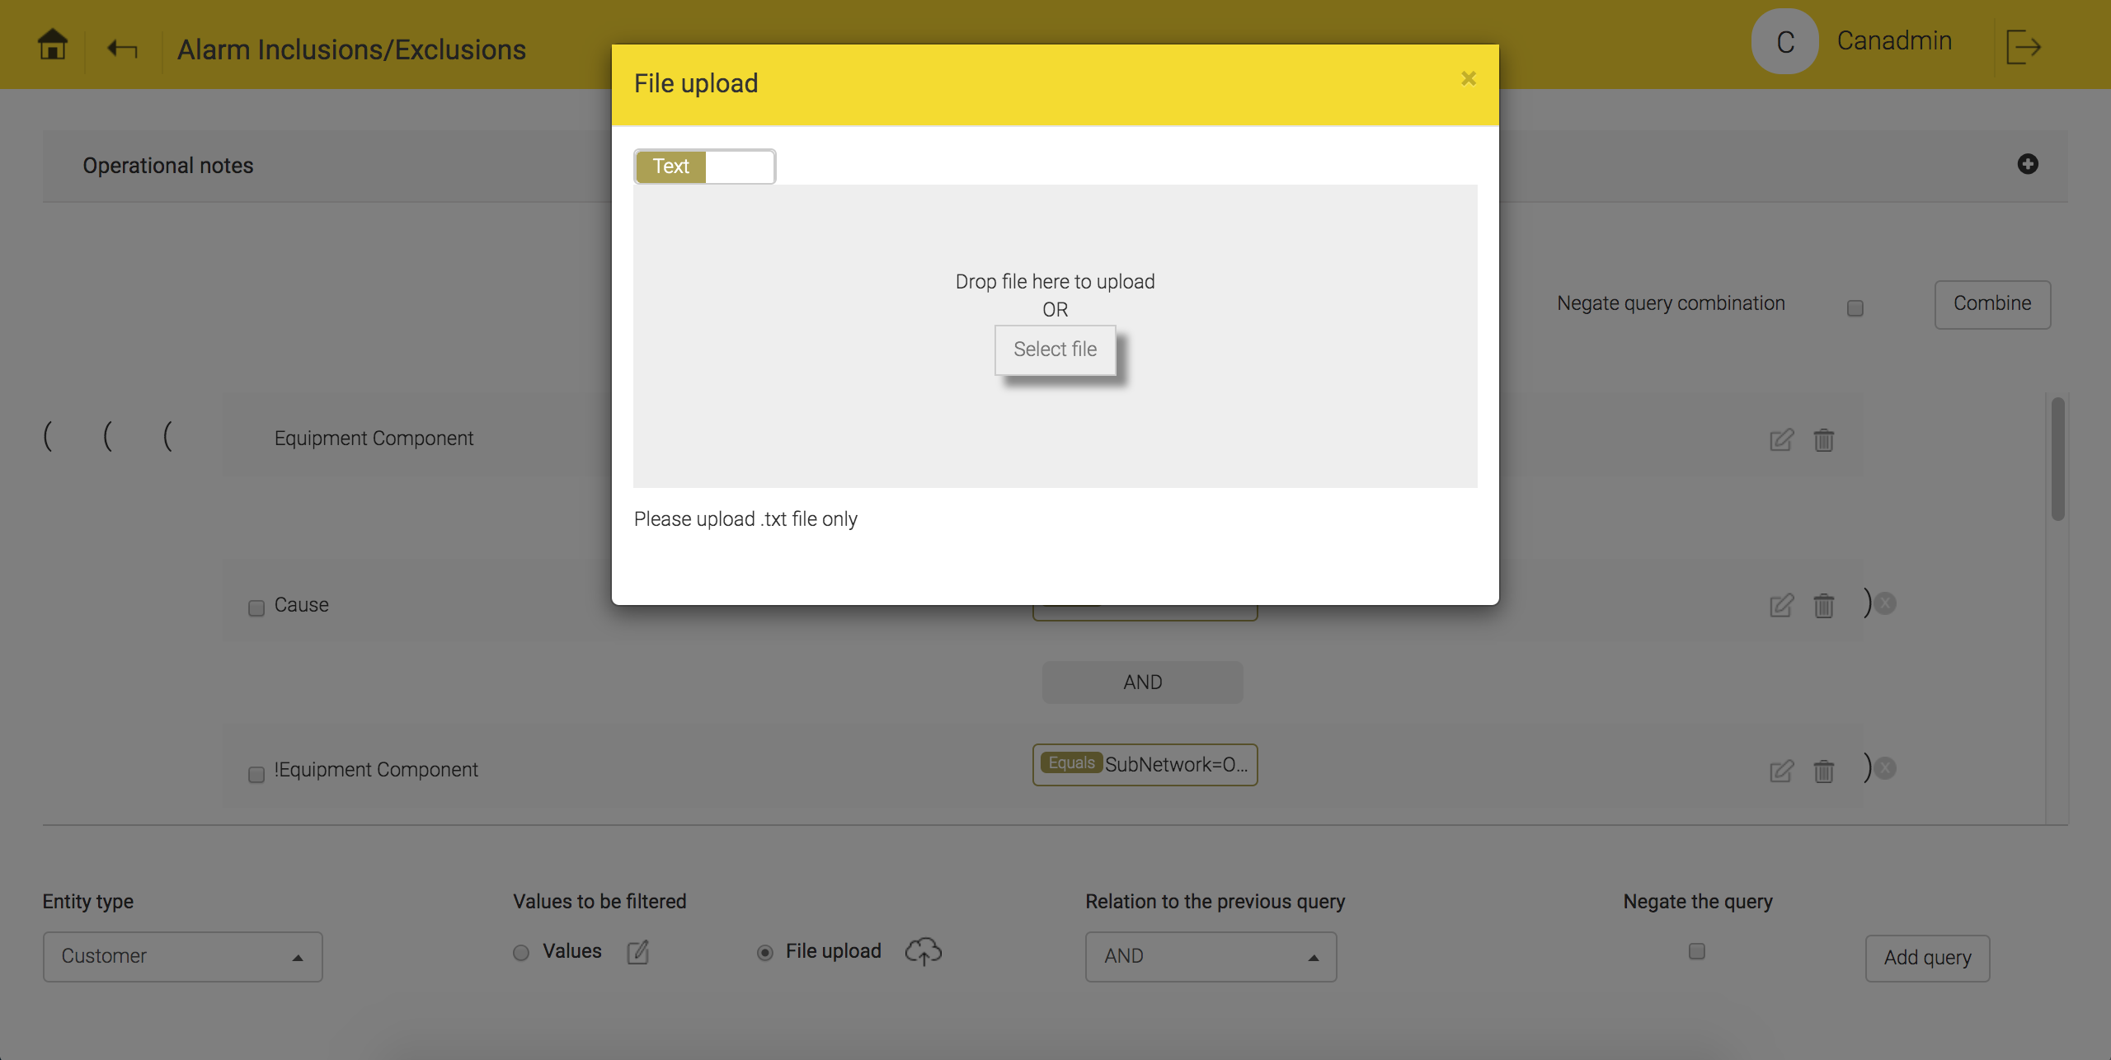
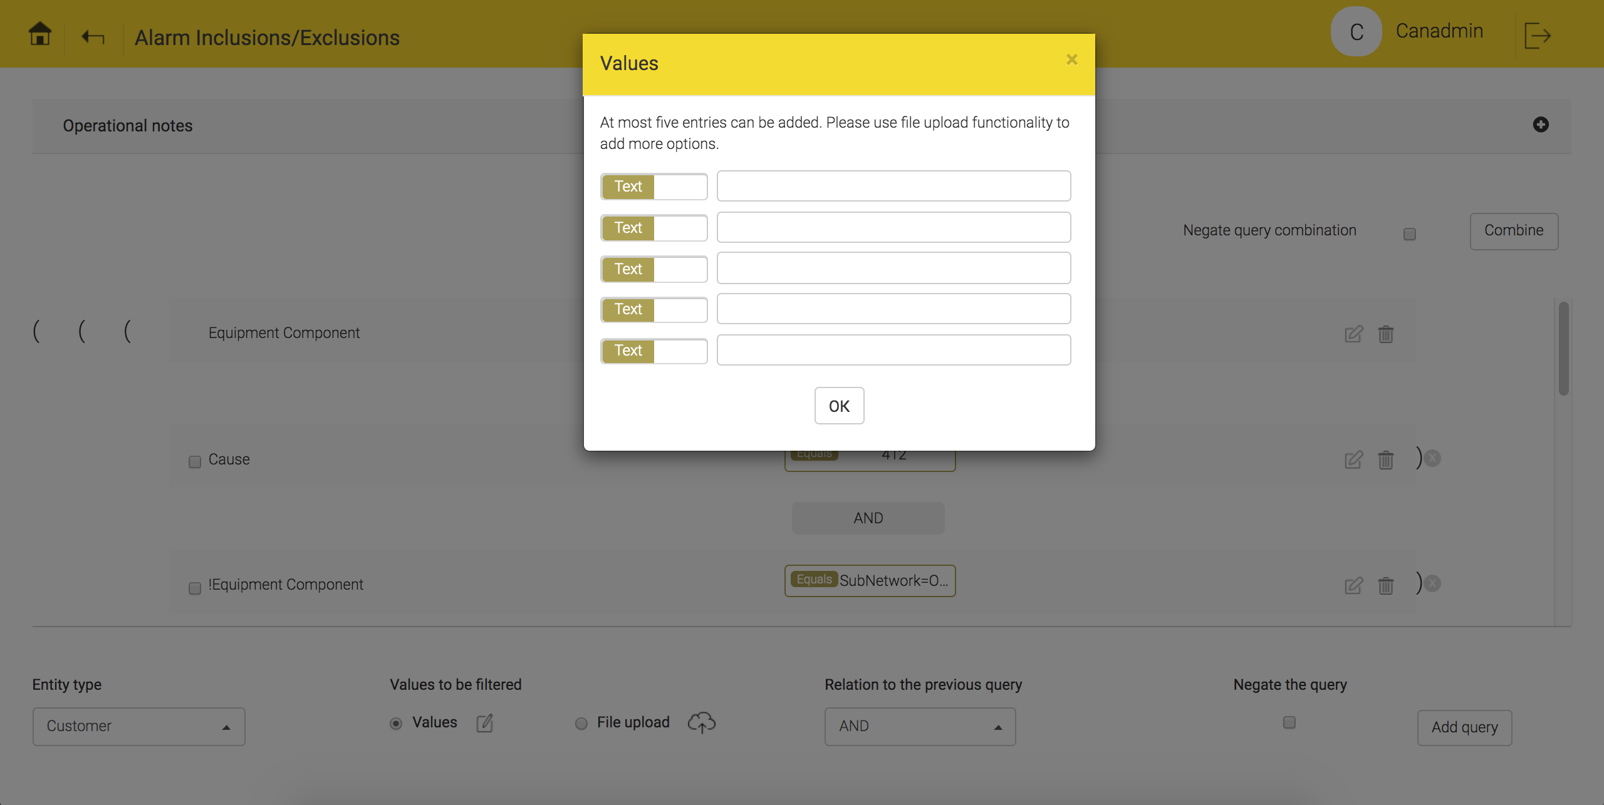
Alarm filtering configuration – Configuration snapshots
Snapshots show different ways to apply alarm filters like text, regular expression & file upload
Basic alarm filter configuration
Regular expression query configuration
File upload based filter query configuration
Text based query configuration

